Slide 1
Neural Networks and Deep Learning
Dr. Nassim Sohaee

Slide 2
Timeline
1943
ANN introduced by neurophysiologist Warren McCulloch and the mathematician Walter Pitts.
1957
Perceptron
1960s
back propagation
1980s
revival of interest in ANNs
1990's
powerful alternative Machine Learning techniques such as Support Vector Machines were favored by most researchers.
2011
introduction of GPUs
Now
another wave of interest in ANNs

Slide 3
Logical Computations with Neurons
Warren McCulloch and Walter Pitts proposed a very simple model of the biological neuron, which later became known as an artificial neuron.
An artificial neuron has one or more binary (on/off) inputs and one binary output.
The artificial neuron simply activates its output when more than a certain number of its inputs are active.
They proved this simplified model can build a network of artificial neurons that computes any logical proposition.

Slide 4
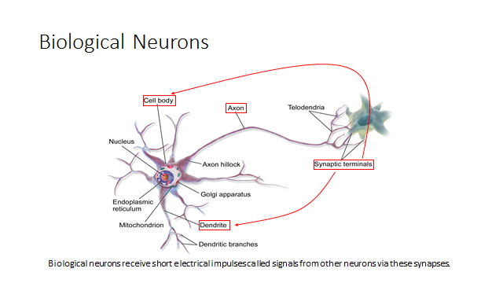
Background
Several interconnected neurons, organized in layers, which exchange messages when certain conditions satisfied.

Slide 5
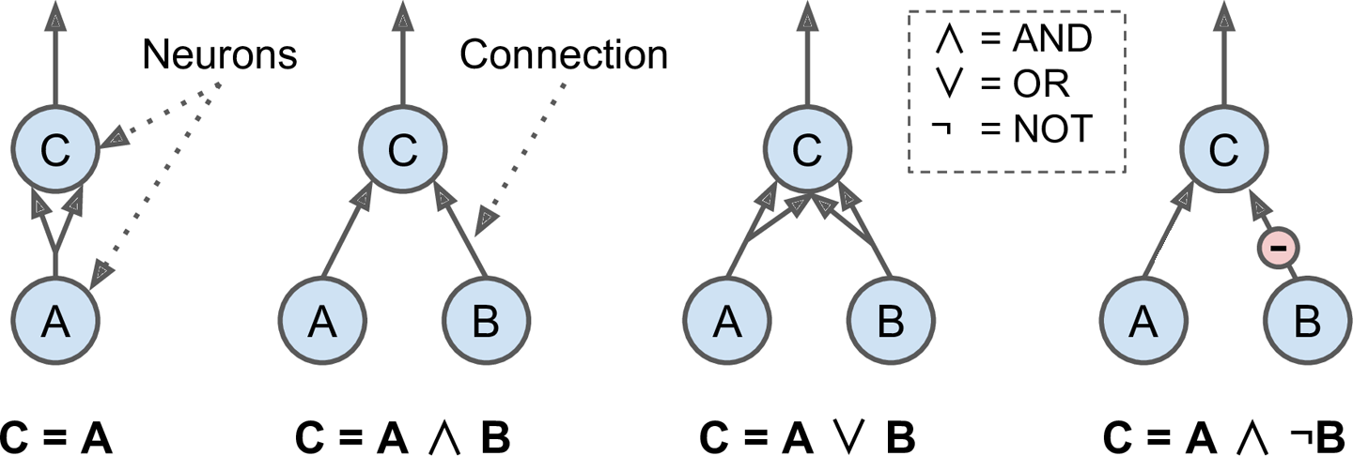
Logical Computations with Neurons
Notes:
The first network on the left is simply the identity function: if neuron A is activated, then neuron C gets activated as well (since it receives two input signals from neuron A), but if neuron A is off, then neuron C is off as well.
The second network performs a logical AND: neuron C is activated only when both neurons A and B are activated (a single input signal is not enough to activate neuron C).
The third network performs a logical OR: neuron C gets activated if either neuron A or neuron B is activated (or both).
Finally, if we suppose that an input connection can inhibit the neuron’s activity (which is the case with biological neurons), then the fourth network computes a slightly more complex logical proposition: neuron C is activated only if neuron A is active and if neuron B is off. If neuron A is active all the time, then you get a logical NOT: neuron C is active when neuron B is off, and vice versa.
Now that we have learned basic logical operators, we can combine them to make complex logical expressions.

Slide 6
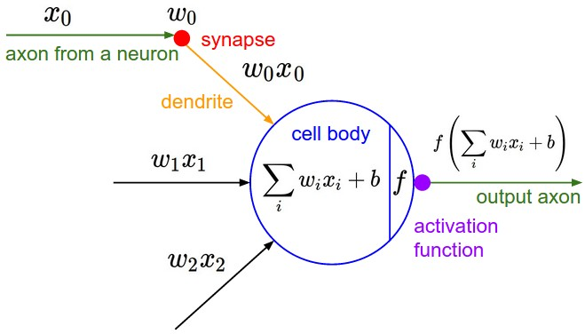
Perceptron
The Perceptron is one of the simplest ANN architectures, invented in 1957 by Frank Rosenblatt.

Slide 7

Perceptron
Common step function:
Linear threshold unit can be used for simple binary classification.
It computes a linear combination of the inputs and if the results exceeds a threshold, it outputs the positive class or else outputs the negative class.

Slide 8
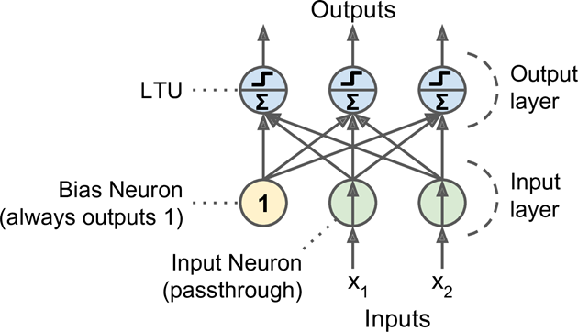
Multi-Class Classification
Notes:
The bias Neuron outputs 1 all the time.

Slide 9

Perceptron training
Hebb's rule: Cells that fire together, wire together.
connection weight between the i^{th} input neuron and the j^{th} output neuron.
Learning rate
i^{th} input value of the current training instance.

Slide 10
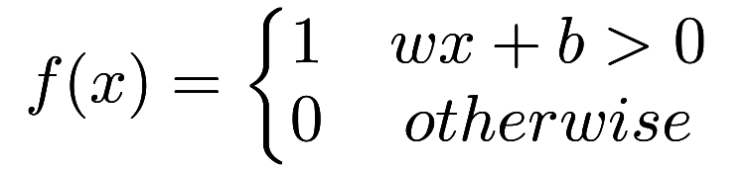
Perceptron
A simple perceptron can be famulated as

Slide 11
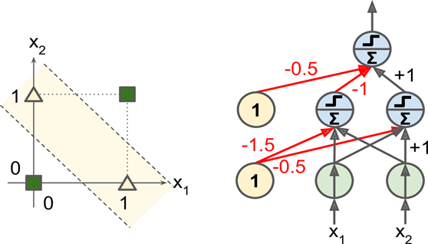
Single Layer Perceptron
Perceptron does not output a class probability, they just make predictions based on a hard threshold.
Like any other linear classification they are incapable of solving some trivial problems, for example XOR

Slide 12
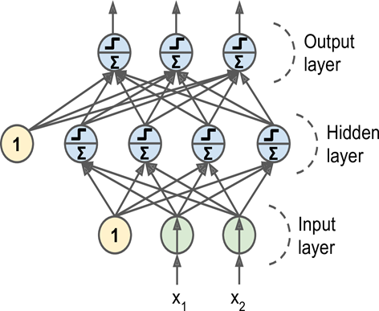
Multi-Layer Perceptron

Slide 13
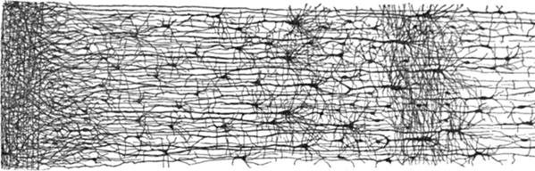
Dense Layer
The network is dense, meaning that each neuron in a layer is connected to all neurons located in the previous layer and to all the neurons in the following layer.

Slide 14
Back Propagation
make a prediction (forward pass)
measure the error
go through each layer in reverse to measure the error contribution from each connection (reverse pass)
tweak the weights to reduce the error

Slide 15
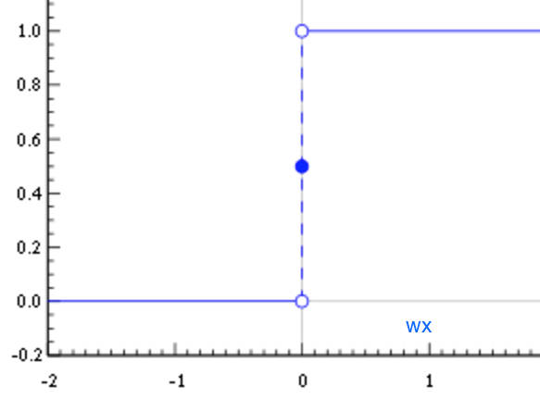
Step Function?

Slide 16
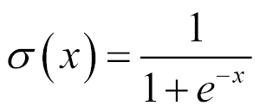
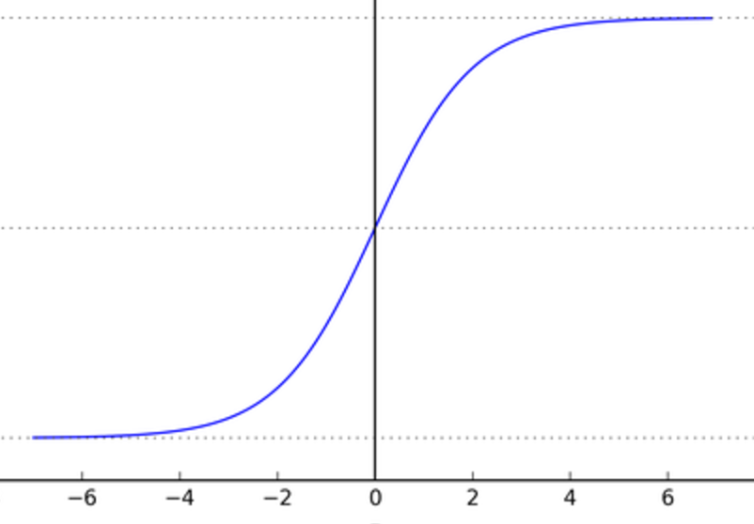
Sigmoid

Slide 17
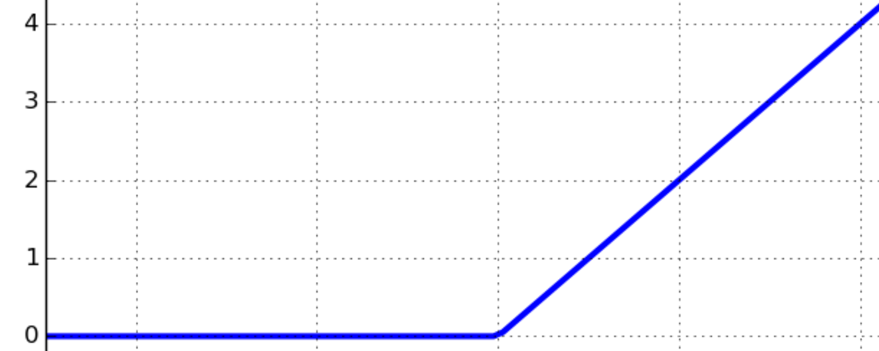
ReLU
f(x) = max(0,x)

Slide 18
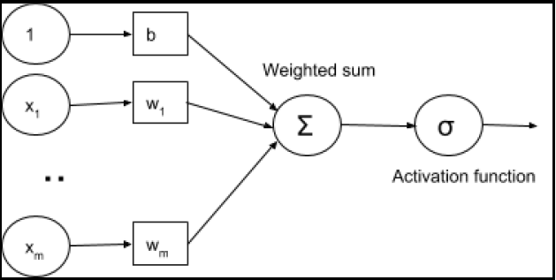
Activation Function

Slide 19
Number of Hidden Layers
begin with a single hidden layer
deep networks have a much higher parameter efficiency than shallow ones
DNN converges faster
Generalize better

Slide 20
Number of Neurons per Hidden Layers
Input and output layer: input dataset and project description.
Hidden layers: form a funnel

Slide 21
Activation Function
Input layer
ReLU or Sigmoid
Hidden layer
ReLU
Output layer
Classification: Softmax, Logistic
Regression: None

Slide 22
Defining a simple neural net in Keras
0
1
9
b
x1
x2
x784

Slide 23
Compile Model
Optimizer
Objective Function/Loss Function
Evaluation method

Slide 24
Optimizer
Speed up training process:
Good initialization strategy
Good activation function
Faster optimizer
Popular optimizers:
Momentum optimization
Nesterov Accelerated Gradient
AdaGrad
RMSProp
Adam optimization.

Slide 25
Adam Optimizer
Adam: adaptive moment estimation
Adam configuration parameter:
Alpha
Beta1
Beta2
Epsilon
Adam is a popular algorithm in the field of deep learning because it achieves good results fast.

Slide 26


Objective Function/Loss Function
MSE
Binary cross-entropy:
Categorical cross-entropy:

Slide 27
Fit the model
epochs: number of times the model is exposed to the training set. At each iteration, the optimizer tries to adjust the weights so that the objective function is minimized.
batch_size: number of training instances observed before the optimizer performs a weight update.

